Slide 1
Azure SQL Database Administration
Module 2

Slide 3
Learning Units covered in this Module
Lesson 1: Various Tools to Manage Azure SQL Database
Lesson 2: Scaling Azure SQL Databases Up and Down
Lesson 3: Maintenance and Scheduling Jobs in Azure SQL Database
Lesson 4: Azure SQL Database Read Scale-Out

Slide 4
Lesson 1: Various Tools to Manage Azure SQL Database

Slide 5

Objectives
After completing this learning, you will be able to:
Know the different tools that you can use to manage your Azure SQL Database.
Notes:
In this lesson we will be covering the various tools used to manage an Azure SQL Database.

Slide 6
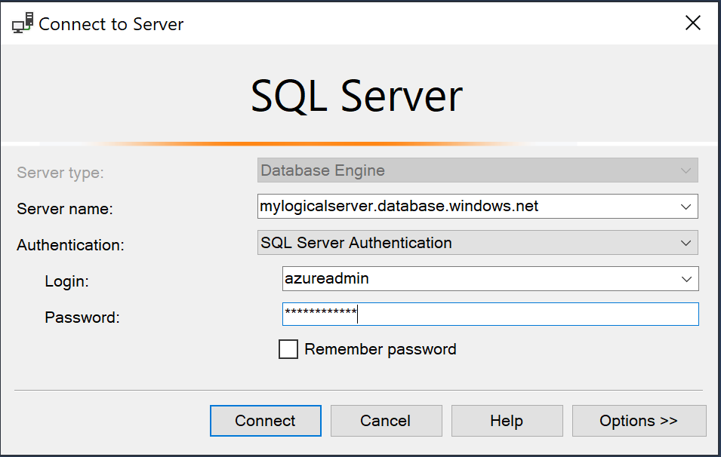
SQL Server Management Studio
Download the latest version of SSMS.
Get the fully qualified domain name of your Azure SQL Server.
Connect to your SQL Database.
Notes:
You can use SQL Server Management Studio (SSMS) by providing your FQDN:
<Server name>.database.windows.net
And providing a valid Login and Password.
Always use the latest version of SSMS because it is continually improved to work with the latest updates to Azure and SQL Database. Some old versions of management cannot connect to a SQL Azure database.

Slide 7
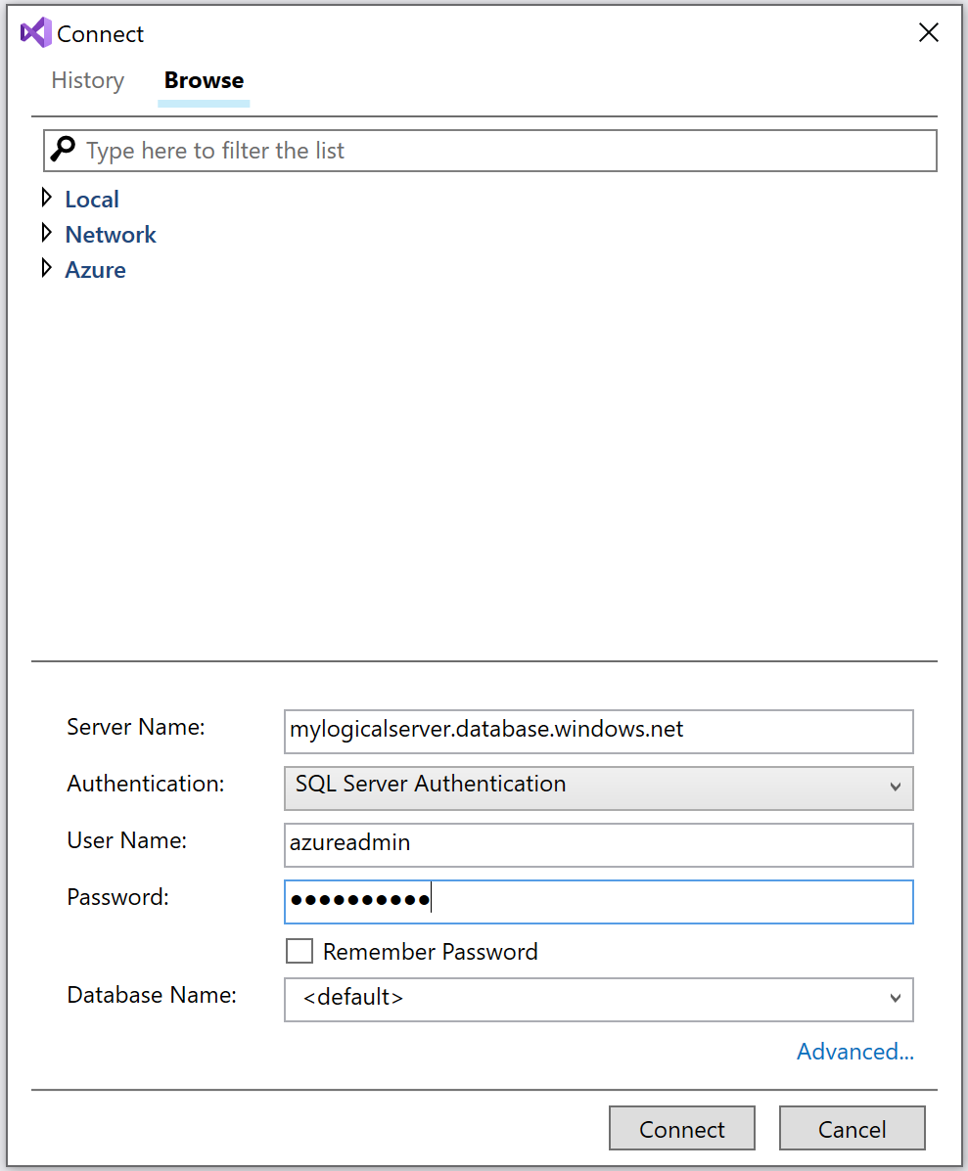
SQL Server Data Tools
Download the latest version of SSDT.
Get the fully qualified domain name of your Azure SQL Server.
Connect to your SQL Database.
Notes:
You can use SQL Server Data Tools (SSDT) by providing your FQDN:
<Server name>.database.windows.net
And providing a valid Login and Password.

Slide 8
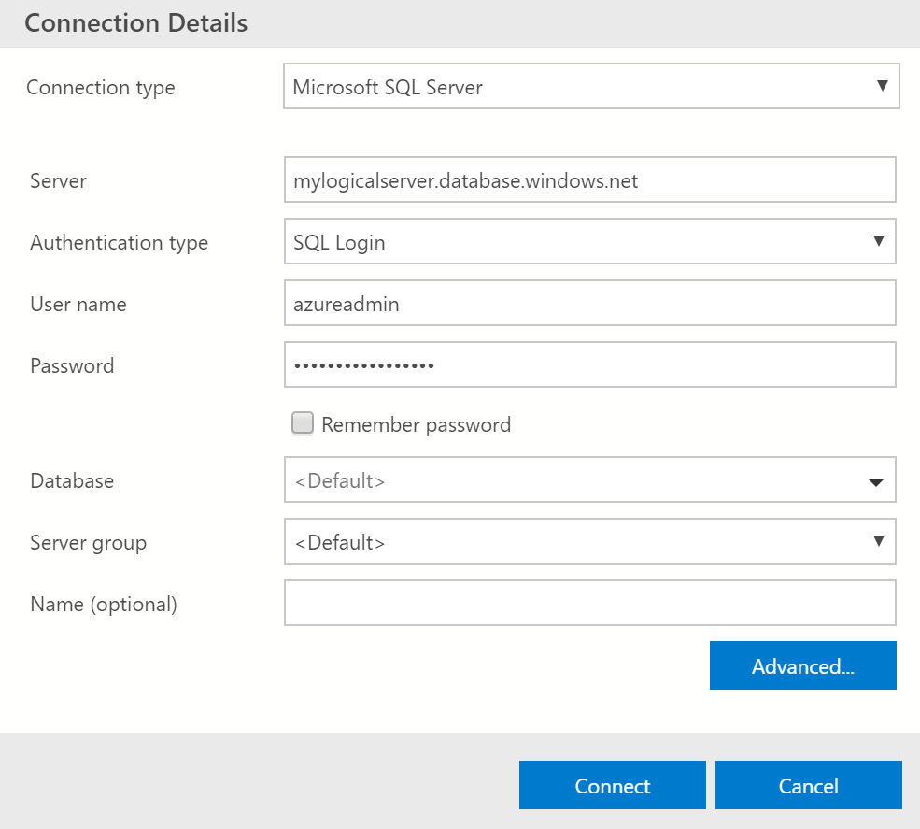
Azure Data Studio
Download the latest version of Azure Data Studio.
Get the fully qualified domain name of your Azure SQL Server.
Connect to your SQL Database.
Notes:
Azure Data Studio is a cross-platform database tool for data professionals running on Windows, MacOS, and Linux which offers a modern editor experience with Intellisense, code snippets, source control integration, and an integrated terminal. It is engineered with built in charting of query result sets and customizable dashboards.

Slide 9
Management APIs
PowerShell
New-AzSqlDatabase
Get-AzSqlDatabase
Set-AzSqlDatabase
Remove-AzSqlDatabase
New-AzResourceGroup
New-AzSqlServer
Get-AzSqlServer
Set-AzSqlServer
Remove-AzSqlServer
New-AzSqlServerFirewallRule
Get-AzSqlServerFirewallRule
Set-AzSqlServerFirewallRule
Remove-AzSqlServerFirewallRule
New-AzSqlServerVirtualNetworkRule
Azure CLI
az sql db create
az sql db list
az sql db list-editions
az sql db list-usages
az sql db show
az sql db update
az sql db delete
az group create
az sql server create
az sql server list
az sql server list-usages
az sql server show
az sql server update
az sql server delete
az sql server firewall-rule create
az sql server firewall-rule list
az sql server firewall-rule show
az sql server firewall-rule update
az sql server firewall-rule delete
Notes:
https://docs.microsoft.com/en-us/azure/sql-database/sql-database-single-databases-manage
PowerShell
Cmdlet Description
New-AzSqlDatabase Creates a database
Get-AzSqlDatabase Gets one or more databases
Set-AzSqlDatabase Sets properties for a database, or moves an existing database into an elastic pool
Remove-AzSqlDatabase Removes a database
New-AzResourceGroup Creates a resource group
New-AzSqlServer Creates a server
Get-AzSqlServer Returns information about servers
Set-AzSqlServer Modifies properties of a server
Remove-AzSqlServer Removes a server
New-AzSqlServerFirewallRule Creates a server-level firewall rule
Get-AzSqlServerFirewallRule Gets firewall rules for a server
Set-AzSqlServerFirewallRule Modifies a firewall rule in a server
Remove-AzSqlServerFirewallRule Deletes a firewall rule from a server.
New-AzSqlServerVirtualNetworkRule Creates a virtual network rule, based on a subnet that is a Virtual Network service endpoint.
Azure CLI
Cmdlet Description
az sql db create Creates a database
az sql db list Lists all databases and data warehouses in a server, or all databases in an elastic pool
az sql db list-editions Lists available service objectives and storage limits
az sql db list-usages Returns database usages
az sql db show Gets a database or data warehouse
az sql db update Updates a database
az sql db delete Removes a database
az group create Creates a resource group
az sql server create Creates a server
az sql server list Lists servers
az sql server list-usages Returns server usages
az sql server show Gets a server
az sql server update Updates a server
az sql server delete Deletes a server
az sql server firewall-rule create Creates a server firewall rule
az sql server firewall-rule list Lists the firewall rules on a server
az sql server firewall-rule show Shows the detail of a firewall rule
az sql server firewall-rule update Updates a firewall rule
az sql server firewall-rule delete Deletes a firewall rule

Slide 10
Management APIs
Transact-SQL
CREATE DATABASE
ALTER DATABASE
DROP DATABASE
sys.database_service_objectives
sys.dm_db_resource_stats
sys.resource_stats
sys.database_connection_stats
sys.event_log
sp_set_firewall_rule
sys.firewall_rules
sp_delete_firewall_rule
sp_set_database_firewall_rule
sys.database_firewall_rules
sp_delete_database_firewall_rule
REST API
Servers - Create or update
Servers - Delete
Servers - Get
Servers - List
Servers - List by resource group
Servers - Update
Databases - Create or update
Databases - Delete
Databases - Get
Databases - List by elastic pool
Databases - List by server
Databases - Update
Firewall rules - Create or update
Firewall rules - Delete
Firewall rules - Get
Firewall rules - List by server
Notes:
https://docs.microsoft.com/en-us/azure/sql-database/sql-database-single-databases-manage#transact-sql-manage-sql-database-servers-and-single-databases
T-SQL
CREATE DATABASE Creates a new single database. You must be connected to the master database to create a new database.
ALTER DATABASE Modifies an Azure SQL database.
DROP DATABASE Deletes a database.
sys.database_service_objectives Returns the edition (service tier), service objective (pricing tier), and elastic pool name, if any, for an Azure SQL database or an Azure SQL Data Warehouse. If logged on to the master database in an Azure SQL Database server, returns information on all databases. For Azure SQL Data Warehouse, you must be connected to the master database.
sys.dm_db_resource_stats Returns CPU, IO, and memory consumption for an Azure SQL Database database. One row exists for every 15 seconds, even if there is no activity in the database.
sys.resource_stats Returns CPU usage and storage data for an Azure SQL Database. The data is collected and aggregated within five-minute intervals.
sys.database_connection_stats Contains statistics for SQL Database database connectivity events, providing an overview of database connection successes and failures.
sys.event_log Returns successful Azure SQL Database database connections, connection failures, and deadlocks. You can use this information to track or troubleshoot your database activity with SQL Database.
sp_set_firewall_rule Creates or updates the server-level firewall settings for your SQL Database server. This stored procedure is only available in the master database to the server- level principal login. A server-level firewall rule can only be created using Transact-SQL after the first server-level firewall rule has been created by a user with Azure-level permissions
sys.firewall_rules Returns information about the server-level firewall settings associated with your Microsoft Azure SQL Database.
sp_delete_firewall_rule Removes server-level firewall settings from your SQL Database server. This stored procedure is only available in the master database to the server-level principal login.
sp_set_database_firewall_rule Creates or updates the database-level firewall rules for your Azure SQL Database or SQL Data Warehouse. Database firewall rules can be configured for the master database, and for user databases on SQL Database. Database firewall rules are useful when using contained database users.
sys.database_firewall_rules Returns information about the database-level firewall settings associated with your Microsoft Azure SQL Database.
sp_delete_database_firewall_rule Removes database-level firewall setting from your Azure SQL Database or SQL Data Warehouse.
https://docs.microsoft.com/en-us/azure/sql-database/sql-database-single-databases-manage#rest-api-manage-sql-database-servers-and-single-databases
REST API
Servers - Create or update Creates or updates a new server.
Servers - Delete Deletes a SQL server.
Servers - Get Gets a server.
Servers - List Returns a list of servers in a subscription.
Servers - List by resource group Returns a list of servers in a resource group.
Servers - Update Updates an existing server.
Databases - Create or update Creates a new database or updates an existing database.
Databases - Delete Deletes a database.
Databases - Get Gets a database.
Databases - List by elastic pool Returns a list of databases in an elastic pool.
Databases - List by server Returns a list of databases in a server.
Databases - Update Updates an existing database.
Firewall rules - Create or update Creates or updates a firewall rule.
Firewall rules - Delete Deletes a firewall rule.
Firewall rules - Get Gets a firewall rule.
Firewall rules - List by server Returns a list of firewall rules.

Slide 11
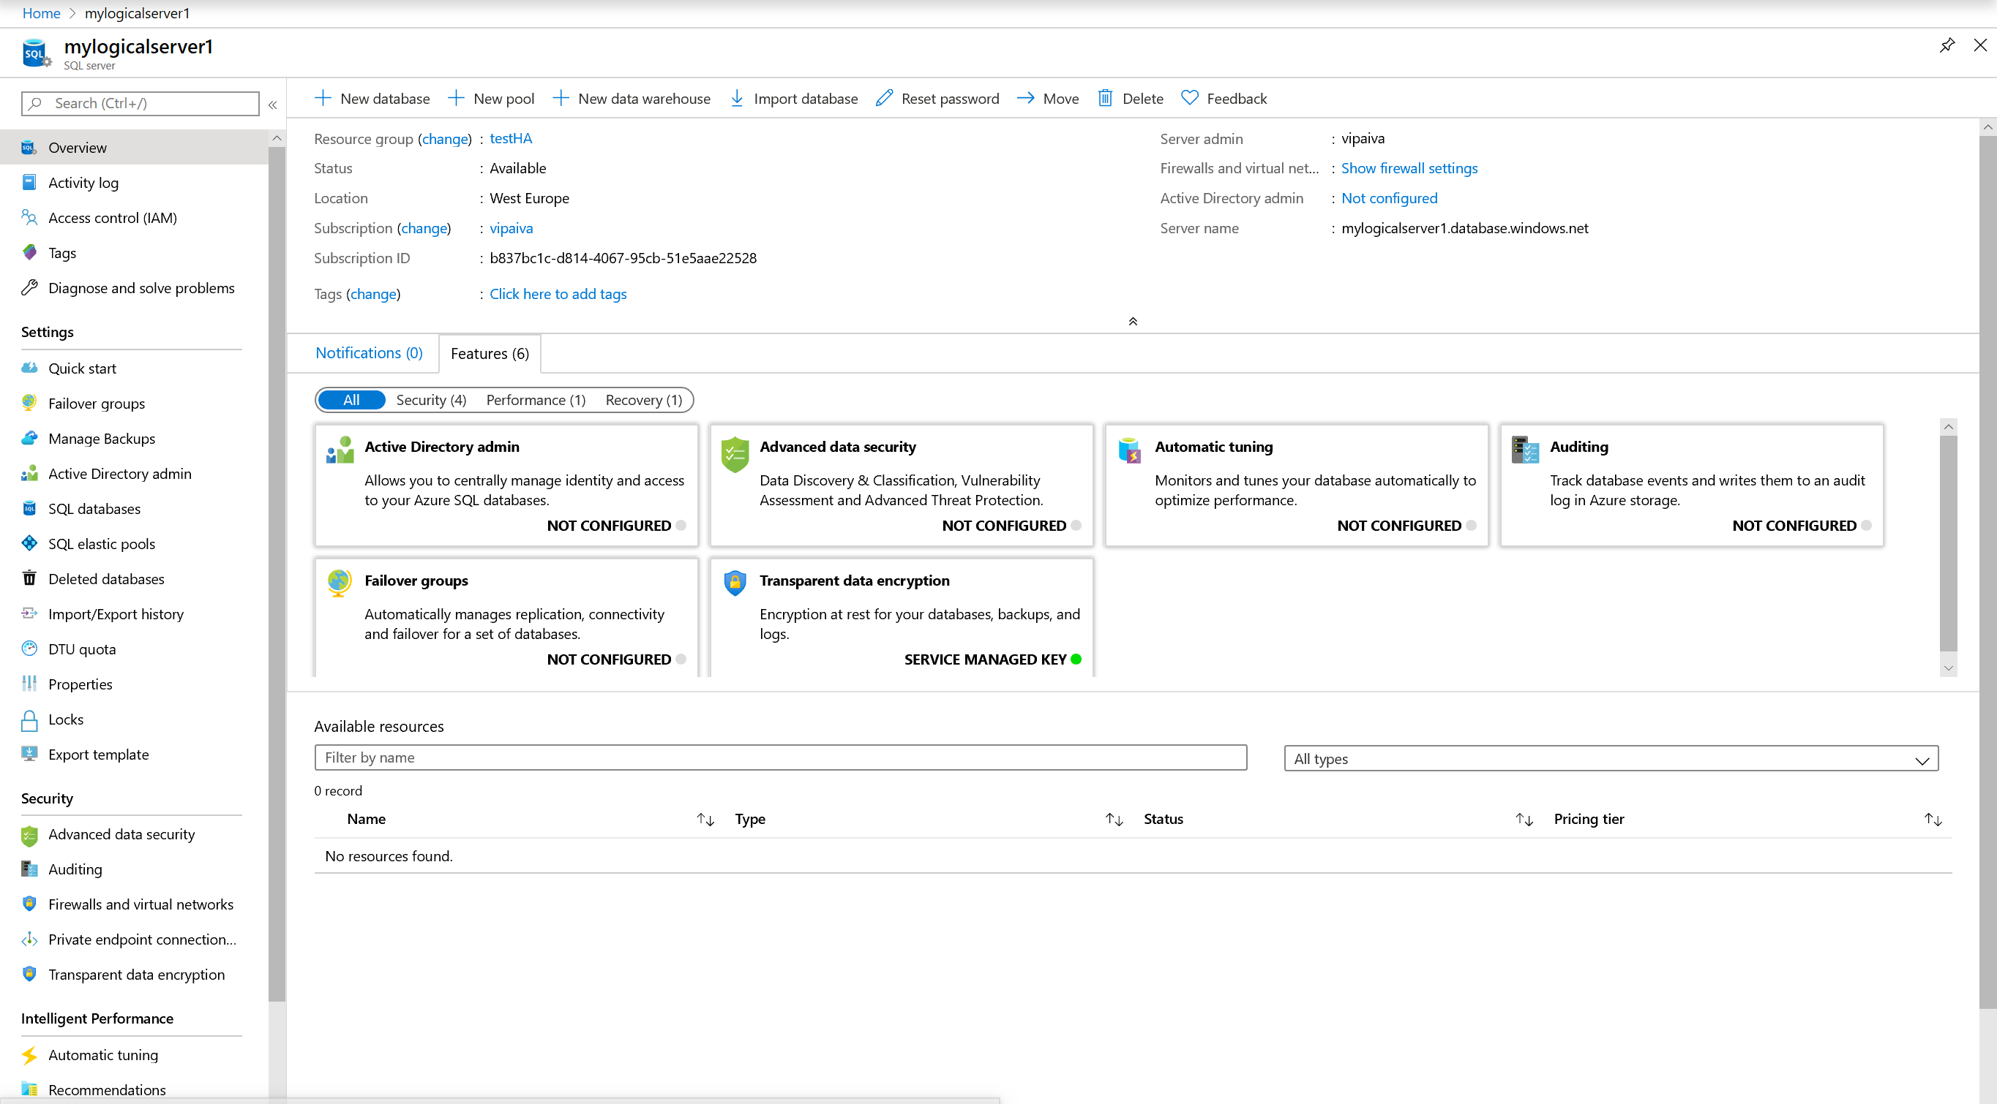
Azure Portal
Notes:
The Azure portal is a web-based application where you can create, update, and delete databases and logical servers and monitor database activity. This tool is great if you're just getting started with Azure, managing a few databases, or need to do something quickly.
https://docs.microsoft.com/en-us/azure/sql-database/sql-database-manage-portal

Slide 12

Demonstration
Connect to your database with SSMS and Azure Portal
Connect to your database with SSMS.
Connect to the portal and explore the different options.
Notes:
M02L01Demo01
Demo setup instructions
Make sure you have the latest version of the SQL Server Management Studio installed
Make sure you have the latest version of the SQL Server Data Tools installed
Use the script C:\Demos\M02L01Demo01\Create Tables in salesdb.sql
Steps
Connect to the Azure logical server with SQL Server Management Studio. Use SQL Authentication and use the Admin Login that you have created.
Examine the database properties and Execute the script “Create Tables in salesdb.sql” to show that it’s just a database. Make sure you are connect to the correct database (salesdb) before running the script.
Connect to the Azure logical server with SQL Server Data Tools and examine the database properties
Connect to the Azure SQL Database with the Azure Portal and examine the database properties. Give a short overview, not in detail because everything will be explained later in the workshop
Overview
Settings
Security
Monitoring
Support + Troubleshooting

Slide 13
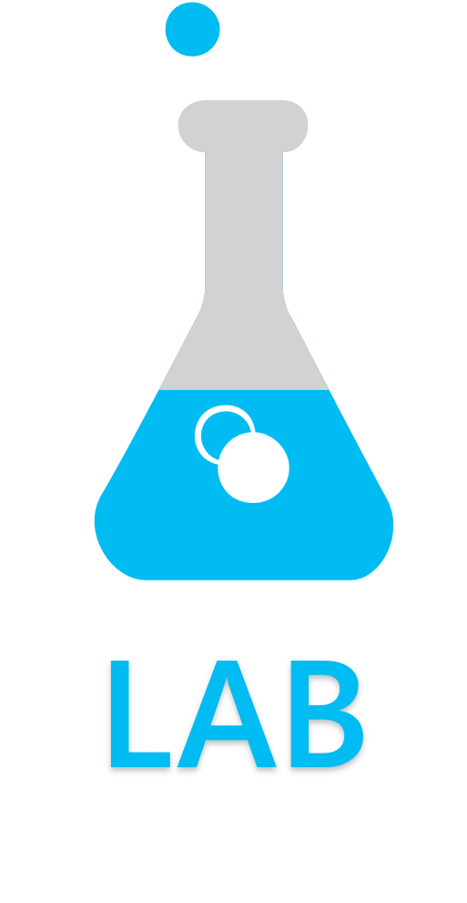
Various Tools to Manage Azure SQL Database
Exercise 1: Connect to your logical server with SQL Server Management Studio.
Exercise 2: Connect to your logical server with SQL Server Data Tools.
Exercise 3: Connect to your Azure SQL Database with Azure Portal.
Notes:
M02L01Lab01

Slide 14

Questions?

Slide 15
Knowledge Check
What are the different tools that you can use to manage your Azure SQL Database?
What is the main recommendation to connect to Azure SQL databases regarding the version of the tools?
Notes:
Q1: What are the different tools that you can use to manage your Azure SQL Database?
Answer 1:
Azure Portal, SSMS, SSDT, CLI and PowerShell.
Q2: What is the main recommendation to connect to Azure SQL databases regarding the version of the tools?
Answer 2:
Always use the latest version.

Slide 16
Lesson 2: Scaling Azure SQL Databases Up and Down

Slide 17
Objectives
After completing this learning, you will be able to:
Describe the vertical scaling options on Azure SQL DB

Slide 18
Introduction – Scale up or down
Scale up with one click.
Accommodate growth and peak workloads.
Pay for what you need, when you need it.
5 | 10 | 20 | 50 | 100 | 125 | 250 | 500 | 1,000 | 1,750 | 4,000
Database transaction units (DTUs)
Basic | Standard | Premium
Notes:
Scales performance on the fly, without app downtime.
When demand for your app grows from a handful of devices and customers to millions, SQL Database is the only service that can scale along with you, on the fly, with no app downtime.
Scale on the fly. With one mouse click in the Portal or a single API call, scale up the resources provided to your app to accommodate growth periods or peak workload demand.
Pay for what you need. Remove the guesswork and commitment of buying infrastructure to support the performance goals for your app. Only pay for the performance you need, when you need it.

Slide 19



Vertical Scaling
Upgrade to a Higher Service Tier
Downgrade to a Lower Service Tier
Change the Performance Level
Notes:
Vertical scaling refers to increasing or decreasing the performance level of an individual database

Slide 20
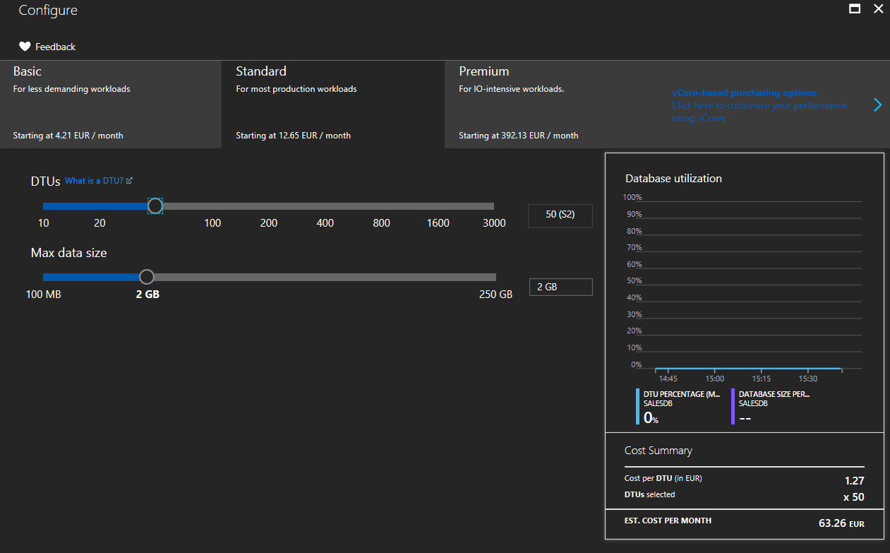
Changing Performance Levels (DTU)
PowerShell
Set-AzSqlDatabase
REST
Update database
Azure CLI
az sql db update
T-SQL
ALTER DATABASE … MODIFY (EDITION = …)
Notes:
You can change the service tier and performance level of your SQL database with the Azure portal, PowerShell (using the Set-AzureSqlRmDatabase cmdlet), the Service Management REST API (using the Update Database command), or Transact-SQL (via the ALTER DATABASE statement). You can use DMVs to monitor the progress of the upgrade operation for a database. This allows you to easily scale up or down a database, and it will remain online and available during the entire operation with no downtime.
https://docs.microsoft.com/en-us/azure/sql-database/sql-database-manage-single-databases-powershell
https://docs.microsoft.com/en-us/azure/sql-database/sql-database-manage-single-databases-portal

Slide 21
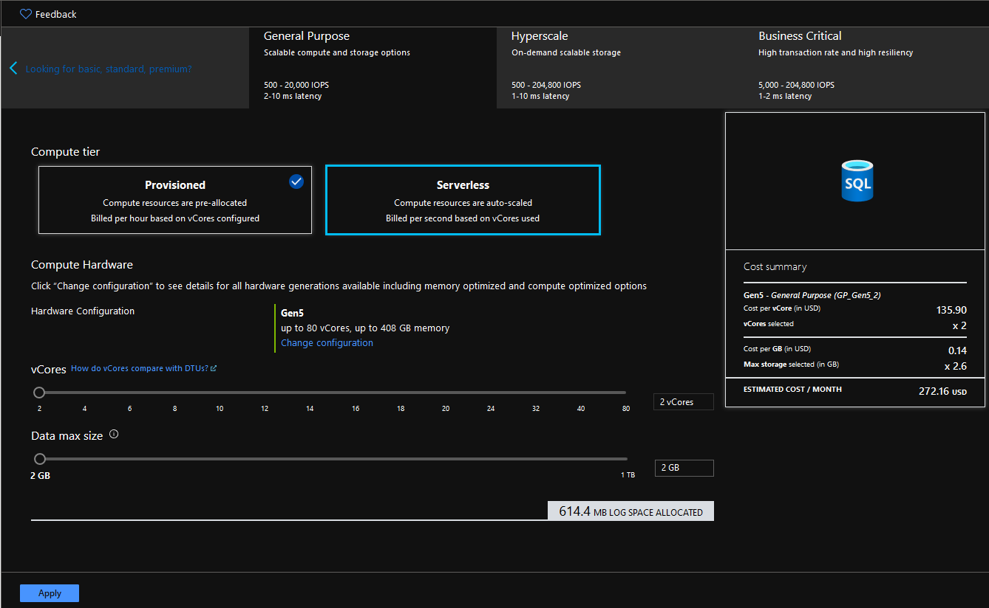
Changing Performance Levels (vCore)
PowerShell
Set-AzSqlDatabase
REST
Update database
Azure CLI
az sql db update
T-SQL
ALTER DATABASE … MODIFY (EDITION = …)
Notes:
You can change the service tier and performance level of your SQL database with the Azure portal, PowerShell (using the Set-AzureRmSqlDatabase cmdlet), the Service Management REST API (using the Update Database command), or Transact-SQL (via the ALTER DATABASE statement). You can use DMVs to monitor the progress of the upgrade operation for a database. This allows you to easily scale up or down a database, and it will remain online and available during the entire operation with no downtime.
https://docs.microsoft.com/en-us/azure/sql-database/sql-database-manage-single-databases-powershell
https://docs.microsoft.com/en-us/azure/sql-database/sql-database-manage-single-databases-portal

Slide 22
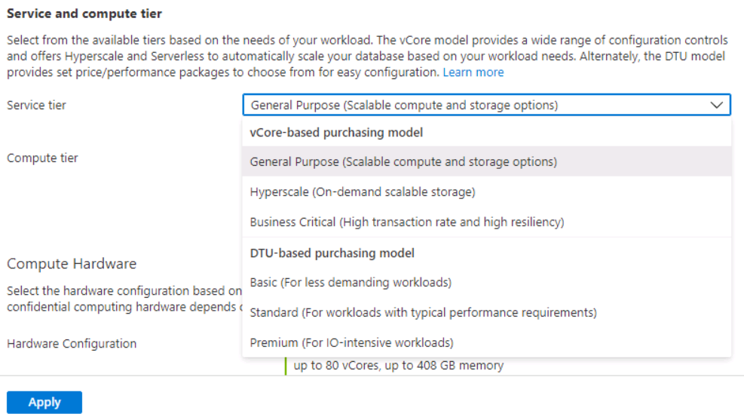
Changing Performance Levels (New Layout)
Notes:
You can change the service tier and performance level of your SQL database with the Azure portal, PowerShell (using the Set-AzureRmSqlDatabase cmdlet), the Service Management REST API (using the Update Database command), or Transact-SQL (via the ALTER DATABASE statement). You can use DMVs to monitor the progress of the upgrade operation for a database. This allows you to easily scale up or down a database, and it will remain online and available during the entire operation with no downtime.
https://docs.microsoft.com/en-us/azure/sql-database/sql-database-manage-single-databases-powershell
https://docs.microsoft.com/en-us/azure/sql-database/sql-database-manage-single-databases-portal

Slide 23
Impact of Database Changes
Connections to the database may be temporarily dropped
No data is lost during this process
The duration depends on both size and service tier
Changing to, from, within Standard Tier of 250 GB database < 6 hours
Changing within Premium Tier of 250 GB database < 3 hours
Notes:
Changing the service tier and/or performance level of a database creates a replica of the original database at the new performance level, and then switches connections over to the replica. No data is lost during this process but during the brief moment when we switch over to the replica, connections to the database are disabled, so some transactions in flight may be rolled back. The length of time for the switch-over varies, but is less than 30 seconds 99% of the time. If there are large numbers of transactions in flight at the moment connections are disabled, the length of time for the switch-over may be longer.
The duration of the entire scale-up process depends on both the size and service tier of the database before and after the change. For example, a 250-GB database that is changing to, from, or within a Standard service tier, should complete within six hours. For a database the same size that is changing performance levels within the Premium service tier, the scale-up should complete within three hours.

Slide 24
Impact of Database Changes (continued)
Downgrading the service tier can cause a change in the backup retention periods.
Changing your database pricing tier does not automatically change the max database size.
Notes:
The duration of the entire scale-up process depends on both the size and service tier of the database before and after the change. For example, a 250 GB database that is changing to, from, or within a Standard service tier, should complete within 6 hours. For a database of the same size that is changing performance levels within the Premium service tier, it should complete within 3 hours.
o downgrade a database, the database should be smaller than the maximum allowed size of the target service tier.
When upgrading a database with Geo-Replication enabled, you must first upgrade its secondary databases to the desired performance tier before upgrading the primary database.
When downgrading from a Premium service tier, you must first terminate all Geo-Replication relationships. You can follow the steps described in the Recover from an outage topic to stop the replication process between the primary and the active secondary databases.
The restore service offerings are different for the various service tiers. If you are downgrading you may lose the ability to restore to a point in time, or have a lower backup retention period. For more information, see Azure SQL Database Backup and Restore.
The new properties for the database are not applied until the changes are complete.

Slide 25
Demonstration
Scale up an Azure SQL Database
Scale up an Azure SQL Database and verify that the database has moved to the selected pricing tier.
Notes:
M02L02Demo01
Demo setup instructions
Make sure you have created the salesdb from Module 1.
Steps
Open the SQL Database blade for the database you want to scale up or down:
Go to the Azure portal.
Click BROWSE ALL.
Click SQL databases.
Click the database you want to change. (SalesDB)
On the SQL Database blade click Settings, then click Configure
Select a new tier and click Select. You can also show that you can change the DTU model to vCore model
Clicking Apply submits a scale request to change the database tier.
Verify the database is at the selected pricing tier
After the scaling operation is complete inspect and confirm the database is at the desired tier:
Click BROWSE ALL.
Click SQL databases.
Click the database you updated.
Check the Pricing tier and confirm it is set to the correct tier.

Slide 26
Scale up or down an Azure SQL Database
Exercise 1: Scale up\down an Azure SQL Database.
Exercise 2: Verify the database is at the selected pricing tier.
Notes:
M02L02Lab01

Slide 27
Questions?

Slide 28
Knowledge Check
True or false: Database will remain offline and unavailable during the scale up\down operation.
What are the various methods to change the performance levels and edit?
Notes:
Question 1: True or false: Database will remain offline and unavailable during the scale up\down operation.
Answer 1 : False. Database will remain online and available during the scale up\down operation.
Question 2: What are the various methods to change the performance levels and edit?
Answer 2: You can change the service tier and performance level of your SQL database with the Azure portal, PowerShell (using the Set-AzSqlDatabase cmdlet), the Service Management REST API (using the Update Database command), or Transact-SQL (via the ALTER DATABASE statement).

Slide 29
Lesson 3: Maintenance and Scheduling Jobs in Azure SQL Database

Slide 30
Objectives
After completing this learning, you will be able to:
Understand how to perform maintenance and job scheduling in Azure SQL Database

Slide 31



Maintenance Tasks
Index maintenance as is on premises.
Update statistics as is on premises.
Support for running DBCC CHECKDB.
Notes:
Just like an on-premises database, you also have to maintain your indexes and statistics because indexes can also get fragmented on an Azure SQL Database.
We don’t currently recommend customers rebuild indexes regularly unless there is a specific performance or resource need to do so.
Note: Though CHECKDB is supported , it is recommended that you don’t run it that often.
Azure SQL DB provides a number of features as part of that service, one of which is that the service providers already have code and people regularly looking for and fixing any corruption issues so that customers don’t have to. Microsoft manages the HA system and can automatically detect and fix a number of corruptions without any human approach.
Checkdb takes resources from the resource container for which you are paying in Azure SQL DB

Slide 32
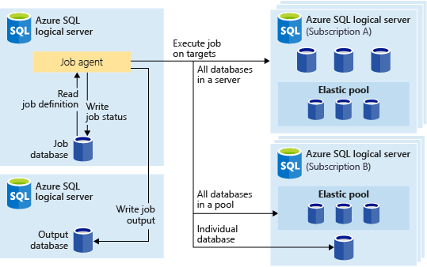
What are Elastic Database Jobs?
Elastic Database Jobs provide the ability to run one or more T-SQL scripts in parallel, across a large number of databases, on a schedule or on-demand.
Notes:
Elastic Database Jobs provide the ability to run one or more T-SQL scripts in parallel, across a large number of databases, on a schedule or on-demand.
Run jobs against any combination of databases: one or more individual databases, all databases on a server, all databases in an elastic pool, or shardmap, with the added flexibility to include or exclude any specific database. Jobs can run across multiple servers, multiple pools, and can even run against databases in different subscriptions. Servers and pools are dynamically enumerated at runtime, so jobs run against all databases that exist in the target group at the time of execution.

Slide 33
Why use Elastic Jobs?
Manage many databases
Easily do schema changes, credentials management, reference data updates, performance data collection or tenant (customer) telemetry collection.
Schedule administrative tasks for example: Index Maintenance.
Collect data for reporting
Aggregate data from a collection of Azure SQL Databases into a single destination table.
Reduce Overhead
No need to connect to each DB separately.
Scripts are executed against a group of databases.
Flexibility
Define custom groups of Azure SQL Databases, and define schedules for running a job.
Notes:
Manage
Schedule administrative tasks to run every weekday, after hours, etc.
Deploy schema changes, credentials management, performance data collection or tenant (customer) telemetry collection. Update reference data (information common across all databases).
Rebuild indexes to improve query performance. Configure jobs to execute across a collection of databases on a recurring basis, such as during off-peak hours.
Collect query results from a set of databases into a central table on an on-going basis. Performance queries can be continually executed and configured to trigger additional tasks to be executed.
Collect data for reporting
Aggregate data from a collection of Azure SQL Databases into a single destination table.
Reduce overhead
Normally, you must connect to each database independently in order to run Transact-SQL statements or perform other administrative tasks. A job handles the task of logging in to each database in the target group. You also define, maintain and persist Transact-SQL scripts to be executed across a group of Azure SQL Databases.
Accounting
Jobs run the script and log the status of execution for each database. You also get automatic retry when failures occur.
Flexibility
Define custom groups of Azure SQL Databases, and define schedules for running a job.

Slide 34
Elastic Job Components
Component | Description
Elastic Job Agent | The Azure resource you create to run and manage Jobs.
Job Database | An Azure SQL database the job agent uses to store job related data, job definitions, etc.
Target Group | The set of servers, pools, databases, and shard maps to run a job against.
Job | A job is a unit of work that is comprised of one or more job steps. Job steps specify the T-SQL script to run, as well as other details required to execute the script.
Notes:
Elastic Job agent
An Elastic Job agent is the Azure resource for creating, running, and managing jobs. The Elastic Job agent is an Azure resource you create in the portal (PowerShell and REST are also supported).
Creating an Elastic Job agent requires an existing SQL database. The agent configures this existing database as the Job database.
The Elastic Job agent is free. The job database is billed the same rate as any SQL database.
Job database
The Job database is used for defining jobs and tracking the status and history of job executions. The Job database is also used to store agent metadata, logs, results, job definitions, and also contains many useful stored procedures, and other database objects, for creating, running, and managing jobs using T-SQL.
For the current preview, an existing Azure SQL database (S0 or higher) is required to create an Elastic Job agent.
The Job database doesn't literally need to be new, but should be a clean, empty, S0 or higher service tier. The recommended service tier of the Job database is S1 or higher, but really depends on the performance needs of your job(s): number of job steps, how many times, and how frequently jobs are run. For example, an S0 database might be sufficient for a job agent that runs few jobs an hour, but running a job every minute might not be performant enough, and a higher service tier might be better.
Target group
A target group defines the set of databases a job step will execute on. A target group can contain any number and combination of the following:
Azure SQL server - if a server is specified, all databases that exist in the server at the time of the job execution are part of the group. The master database credential must be provided so that the group can be enumerated and updated prior to job execution.
Elastic pool - if an elastic pool is specified, all databases that are in the elastic pool at the time of the job execution are part of the group. As for a server, the master database credential must be provided so that the group can be updated prior to the job execution.
Single database - specify one or more individual databases to be part of the group.
Shardmap - databases of a shardmap.
Job
A job is a unit of work that is executed on a schedule or as a one-time job. A job consists of one or more job steps.
Job step
Each job step specifies a T-SQL script to execute, one or more target groups to run the T-SQL script against, and the credentials the job agent needs to connect to the target database. Each job step has customizable timeout and retry policies, and can optionally specify output parameters.
Job output
The outcome of a job's steps on each target database are recorded in detail, and script output can be captured to a specified table. You can specify a database to save any data returned from a job.
Job history
Job execution history is stored in the Job database. A system cleanup job purges execution history that is older than 45 days. To remove history less than 45 days old, call the sp_purge_history stored procedure in the Job database.

Slide 35
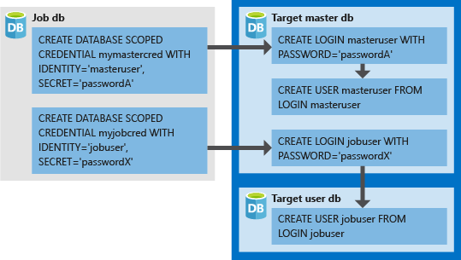
Credentials for running jobs
Database Scoped Credentials
Used to connect to master database
Create a user in every database.
Notes:
Jobs use database scoped credentials to connect to the databases specified by the target group upon execution. If a target group contains servers or pools, these database scoped credentials are used to connect to the master database to enumerate the available databases.
Setting up the proper credentials to run a job can be a little confusing, so keep the following points in mind:
The database scoped credentials must be created in the Job database.
All target databases must have a login with sufficient permissions for the job to complete successfully (jobuser in the diagram below).
Credentials can be reused across jobs, and the credential passwords are encrypted and secured from users who have read-only access to job objects.
The following image is designed to assist in understanding and setting up the proper job credentials. Remember to create the user in every database (all target user dbs) the job needs to run.

Slide 36
Elastic Database Jobs
Create and manage an elastic database job.
Notes:
M02L03Lab01

Slide 37
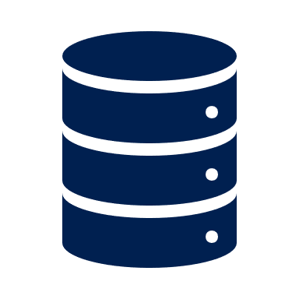

Scheduling Jobs
Microsoft Azure SQL Database does not support SQL Server Agent.
Instead, use Azure Automation or Elastic jobs or use SQL Server Agent from a Linked server.
Notes:
For more information :
https://www.pythian.com/blog/sql-server-jobs-azure-sql-database/

Slide 38
Using SQL Server Agent
Create a linked server to the Azure Database.
Schedule the job from your on-premises or Azure VM SQL Server by using the linked server.
Notes:
More Information:
https://www.pythian.com/blog/sql-server-jobs-azure-sql-database/
https://devjef.wordpress.com/2016/08/22/running-maintenance-on-azure-sql-databases/

Slide 39
Azure Automation
Microsoft Azure Automation provides a way for users to automate the manual, long-running, error-prone, and frequently repeated tasks that are commonly performed in a cloud and enterprise environment.
Notes:
Microsoft Azure Automation provides a way for users to automate the manual, long-running, error-prone, and frequently repeated tasks that are commonly performed in a cloud and enterprise environment. It saves time and increases the reliability of regular administrative tasks and even schedules them to be automatically performed at regular intervals. You can automate processes using runbooks or automate configuration management using Desired State Configuration.

Slide 40
Azure Automation - Runbook
Automating processes with runbooks.
Runbook is a set of tasks that perform some automated process in Azure Automation.
Based on Windows PowerShell/ Windows PowerShell Workflow.
Notes:
More information:
https://azure.microsoft.com/en-us/blog/azure-automation-your-sql-agent-in-the-cloud/

Slide 41
Azure Automation vs. SQL Server Agent Job
Azure Automation | SQL Server Agent Job
Create an Azure Automation Account | Create an SQL Server Agent Job
Create a runbook | Create a Job Step
Test the runbook | Start Job at Step
Publish the runbook | Save the job
Schedule the runbook | Schedule the SQL Server Agent Job
View jobs of the runbook | View History
Notes:
References:
https://azure.microsoft.com/en-us/blog/azure-automation-your-sql-agent-in-the-cloud/
https://blogs.technet.microsoft.com/uktechnet/2016/02/05/is-sql-server-agent-missing-from-azure-sql-database/

Slide 42
Demonstration
Scheduling jobs using Azure Automation
Notes:
M02L03Demo01
Demo setup instructions
Make sure you have created the salesdb from Module 1 and that the database has not the Standard S1 service tier
The goal of this demo is to demonstrate how you can schedule a job with Azure Automation.
You are going to create a runbook that will scale down a database service tier at the end of the day, so save costs
Steps Demo 1 – Create Automation Account
Open the Azure Portal
Click on Create a Resource and search for “Automation”
Select Automation and click Create
Name: Myautomation
Subscription: Select your subscription
Resource Group: use the existing one AzureDB-RG
Location: Select the location that is the closest to your location
Create Azure Run As Account: Yes
Steps Demo 2 – Create Runbook
Click on the Automation Account and Runbooks
Click the button Browse Gallery
Search for “Scale an Azure SQL DB to a specified edition and tier”
Click Import
Go to the runbook and click the Edit button
Click the Publish button to publish the runbook
Steps Demo 3 – Schedule the Runbook
Go to the Runbook and click the Schedule button
Link a schedule to your runbook. Just setup a schedule like you should schedule a SQL job. Create a schedule on daily basis at 22:00
Configure parameters and run settings
RESOURCEGROUPNAME → <The name of the resource group where you have created your logical SQL Server>
SERVERNAME → the name of your logical SQL Server. Just the name of the instance no need to add .database.windows.net
Databasename → Salesdb
DATABASEEDITION → Standard
PRICINGTIER → S1
Click OK to link the schedule to the runbook
Steps Demo 4 – Start the Runbook manually
Go to the runbook and click on the button Start
Configure parameters and run settings
RESOURCEGROUPNAME → <The name of the resource group where you have created your logical SQL Server>
SERVERNAME → the name of your logical SQL Server. Just the name of the instance no need to add .database.windows.net
Databasename → Salesdb
DATABASEEDITION → Standard
PRICINGTIER → S1
Click on the Output button to show the outpot of the job
Wait until the job is finished
Verify if your database is now on Standard S1

Slide 43
Questions?

Slide 44
Knowledge Check
True or False; Index maintenance still needs to be done by the DBA?
True or False; SQL Server Jobs are scheduled as in on premises using SQL Server Agent for Azure SQL database?
Why should you use Elastic Jobs. Give some examples?
Notes:
Question 1: True or False; Index maintenance still needs to be done by the DBA
Answer 1: True; maintenance still needs to be done by the DBA
Question 2: True or False; SQL Server Jobs are scheduled as in on premises using SQL Server Agent for Azure SQL database
Answer 2: False; SQL Server Agent is unavailable in AZURE SQL DB
Question 3: Why should you use Elastic Jobs. Give some examples?
Answer 3:
Manage
Easily do schema changes, credentials management, reference data updates, performance data collection or tenant (customer) telemetry collection.
Reports
Aggregate data from a collection of Azure SQL Databases into a single destination table.
Reduce Overhead
No need to connect to each DB separately
Scripts are executed against a group of databases
Flexibility
Define custom groups of Azure SQL Databases, and define schedules for running a job

Slide 45
Lesson 4: Azure SQL Database Read Scale-Out
Notes:
In this lesson we will be covering the architecture of Azure SQL Database and discussing the different purchase models including the service tiers and the concept of DTUs (Database Transaction Units).

Slide 46
Objectives
After completing this learning, you will be able to:
Use read-only replicas to load balance read-only query workloads

Slide 47
Introduction – Read Scale-Out
Read Scale-Out allows read-only workloads to be redirected to a SINGLE secondary replica.
Notes:
Use read-only replicas to load balance read-only query workloads (preview)
Premium and Business Critical service tiers provides free-of-charge read-only replica in read-only state that can be used for reporting purpose, for example.
Note: Only ONE replica is used, the feature does not use all the available read-only replicas and does not load balance them.
Although the term “load balance” is used here in the notes and in public documentation, it should be noted that there is no true load balancing. Connections with ApplicationIntent=ReadOnly are simply redirected to the secondary replica without regard to workload or connection requests to the primary. This allows you to scale out only. This is not to be confused with read scale out in AGs nor round robin load balancing in an AG in SQL16+.
https://docs.microsoft.com/en-us/azure/sql-database/sql-database-read-scale-out

Slide 48
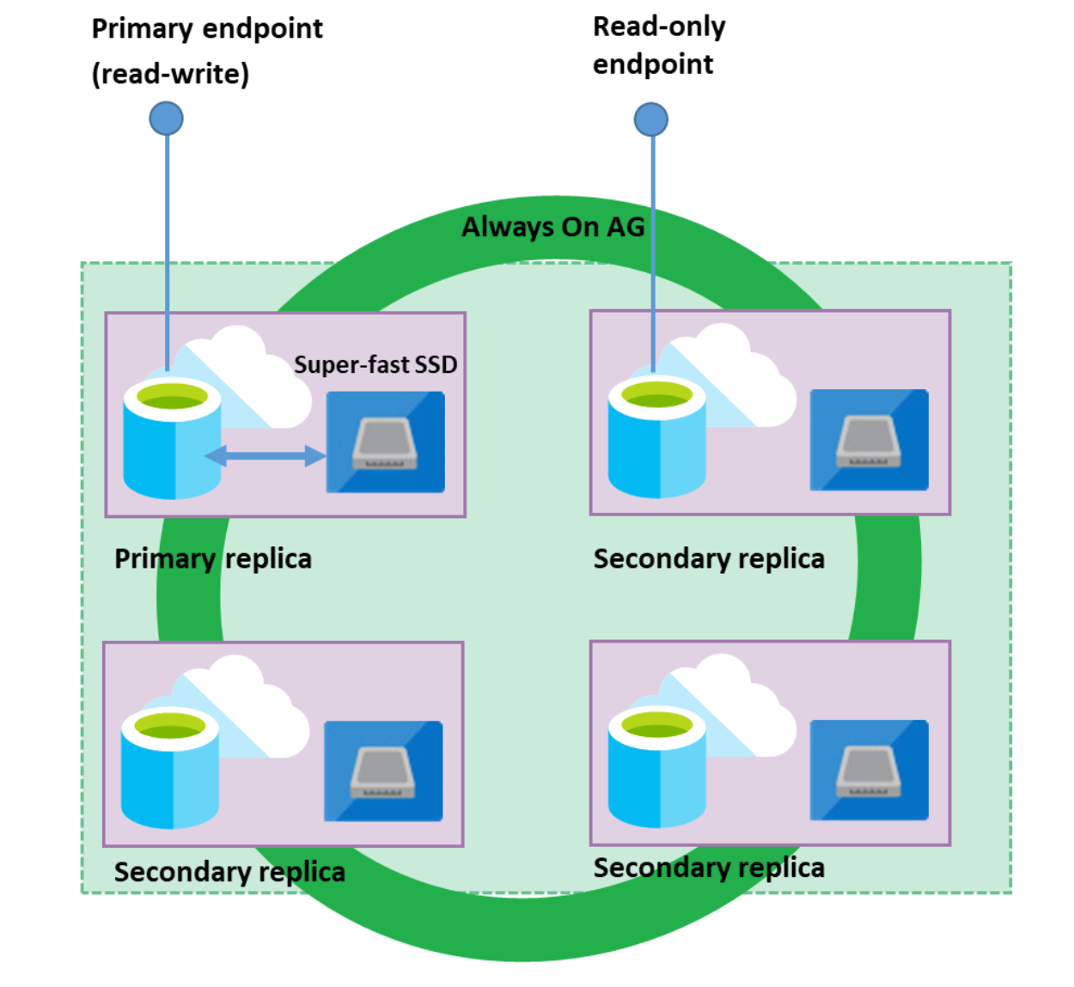
Key Points
Each database in the Premium and Business Critical service tiers is automatically provisioned with several AlwaysON replicas to support the availability SLA. These replicas are provisioned with the same compute size as the read-write.
Read Scale-Out redirects the read-only client connections to one of the ready-only replicas available instead of sharing the read-write replica.
Effectively isolate the read-only workload from the main read-write workload and doubles the compute capacity of the database or elastic pool at no additional charge.
This is ideal to scale-out for complex analytical workloads without affecting the primary OLTP workload.
Notes:
Each database in the Premium tier (DTU-based purchasing model) or in the Business Critical tier (vCore-based purchasing model) is automatically provisioned with several AlwaysON replicas to support the availability SLA.
These replicas are provisioned with the same compute size as the read-write replica used by the regular database connections.
The Read Scale-Out feature allows you to load balance SQL Database read-only workloads using the capacity of one of the read-only replicas instead of sharing the read-write replica.
This way the read-only workload will be isolated from the main read-write workload and will not affect its performance.
The feature is intended for the applications that include logically separated read-only workloads, such as analytics, and therefore could gain performance benefits using this additional capacity at no extra cost.

Slide 49
How to use Read Scale-Out?
If your database is geo-replicated, be sure the read scale-out is enabled on both primary and geo-replicated secondary databases.
Default Configuration
Enabled in Managed Instance Business Critical tier.
Disabled in database placed on SQL Database server Premium and Business Critical tiers.
Setup Methods
Azure Portal
Settings > Configure > Premium/Business Critical tier > Read scale-out.
PowerShell
Set-AzSqlDatabase or
New-AzSqlDatabase cmdlets.
Azure Resource Manager REST API
Create or
Update method
Connection
Applications will be directed to either the read-write replica or to a read-only replica according to the ApplicationIntent property configured in the application’s connection string.
Use ApplicationIntent=ReadOnly; to connect to the read-only replica.
Notes:
Read Scale-Out is enabled by default in Managed Instance Business Critical tier.
It should be explicitly enabled in database placed on SQL Database server Premium and Business Critical tiers.
If Read Scale-Out is disabled or you set the ReadScale property in an unsupported service tier, all connections are directed to the read-write replica, independent of the ApplicationIntent property.
Note: Geo-replicated databases will be covered in detail in module 3: Azure SQL Database Business Continuity.
Using Read Scale-Out with geo-replicated databases
If you are using read scale-out to load balance read-only workloads on a database that is geo-replicated (e.g. as a member of a failover group), make sure that read scale-out is enabled on both the primary and the geo-replicated secondary databases. This will ensure the same load-balancing effect when your application connects to the new primary after failover. If you are connecting to the geo-replicated secondary database with read-scale enabled, your sessions with ApplicationIntent=ReadOnly will be routed to one of the replicas the same way we route connections on the primary database. The sessions without ApplicationIntent=ReadOnly will be routed to the primary replica of the geo-replicated secondary, which is also read-only. Because geo-replicated secondary database has a different end-point than the primary database, historically to access the secondary it wasn't required to set ApplicationIntent=ReadOnly. To ensure backward compatibility, sys.geo_replication_links DMV shows secondary_allow_connections=2 (any client connection is allowed).
Note
Round-robin or any other load balanced routing between the local replicas of the secondary database is not supported.
Note: Query Data Store and Extended Events are not supported on the read-only replicas.

Slide 50
Demonstration
Enable and disable Read Scale-Out
Enabling a database with read scale-out.
Connecting to a Read Scale-Out replica.
Disabling read scale-out.
Notes:
M02L04Demo01
Demo setup instructions
Make sure you have created the salesdb from Module 1.
Step 1: Enabling a database with read scale-out
Connect to the Azure Portal
Navigate to SQL Databases > salesdb > Settings/Configure > Premium > Read scale-out: Enabled > Apply
This changes the tier from Standard to Premium since Read Scale-out is only available in Premium, so it could take some time as we also scale up a tier.
Step 2: Connecting to a Read Scale-Out replica
Connect to the database using SSMS Server name: myazuresrv.database.windows.net Authentication: SQL Server Authentication Login: AzureAdmin Password: Passw0rd1 Navigate to salesdb > Right Click > New Query
Execute the following command: SELECT DATABASEPROPERTYEX(DB_NAME(), 'Updateability’) By default the query will be directed to the READ_WRITE replica
Right click in the query window (keep all the information in the Login tab as it was in the previous connection) > Options >>> in the Connection Properties > Connect to database: salesdb, in the Additional Connection Parameters > add the following parameter: ApplicationIntent=ReadOnly; > Click Connect
Execute the following command: SELECT DATABASEPROPERTYEX(DB_NAME(), 'Updateability') The result will be the READ_ONLY replica
Step 3: Disabling read scale-out
Connect to the Azure Portal
Navigate to SQL Databases > salesdb > Settings/Configure > Premium > Read scale-out: Disabled > Apply
Note: To avoid the charges of Premium tier, change the Tier to Basic/Standard (note that by changing to an unsupported service tier, all connections are directed to the read-write replica, independent of the ApplicationIntent property)

Slide 51
Questions?

Slide 52
Knowledge Check
Read Scale-Out feature is available in which Service Tiers?
How many replicas are enabled to load balance read-only query workloads?
How do you connect to a read-only replica?
Notes:
Question 1: Read Scale-Out feature is available in which Service Tiers?
Answer 1:
Premium tier (DTU-based purchasing model)
Business Critical tier (vCore-based purchasing model)
Hyperscale
Question 2: How many replicas are enabled to load balance read-only query workloads?
Answer 2: Only one
Question 3: How to connect to a read-only replica?
Answer 3: If the feature is available (depend on the service tier) and enabled, you need to modify the connection string parameters adding: ApplicationIntent=ReadOnly;

Slide 53
Module Summary
Various Tools to Manage Azure SQL Database
Scaling Azure SQL Databases Up and Down
Maintenance and Scheduling Jobs in Azure SQL Database
Azure SQL Database Read Scale-Out

